Slide 1
Fitting time series models
CIHR Course Week 2
Michael Law
michael.law@ubc.ca

Slide 2
Teaching Objectives
Describe time series modeling
Learn about key strategies
Plotting
Time trends
Seasonality
Autocorrelation
Discuss two examples

Slide 3
Steps we will cover
Setup data
Visually inspect the data
Perform preliminary analysis
Check for and address autocorrelation
Run the final model and plot the results

Slide 4
Step 1: Setup Data

Slide 5
Data Setup
One data row for each time period, including:
Time variable for day/month/year
Outcome of interest at that time period
Possible variables:
Time Trend
Post-intervention Level Change
Post-intervention Trend Change
Outcome of interest
Notes:
Doing the basic setup for population-level data. Can also use individual data with a similar set of variables (1 line for each observation at each time period)
While you can do this in R, it’s easier in Excel

Slide 6
Month | Visits
2016-01-01 | 557
2016-02-01 | 574
2016-03-01 | 542
2016-04-01 | 793
2016-05-01 | 605
2016-06-01 | 612
2016-07-01 | 685
2016-08-01 | 466
2016-09-01 | 554
2016-10-01 | 698
… | …
Notes:
Average monthly water flow over the year in cubic metres per second

Slide 7
# Load data and add time variable
dataset <- readRDS("session2_data/example_facility_B.rds") %>%
arrange(date) %>%
mutate(time=1:n())
# Print the dataset
dataset

Slide 8
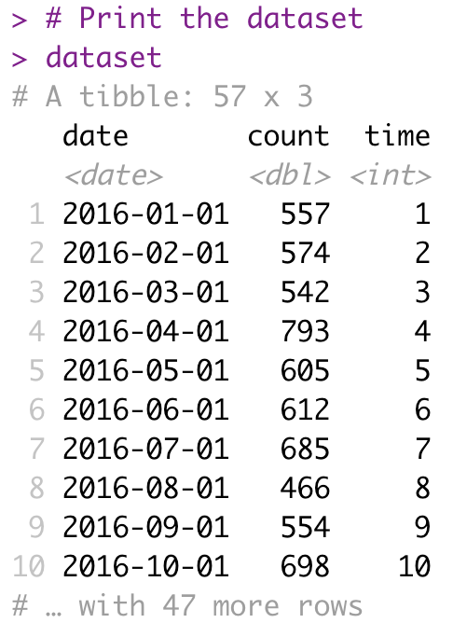
We added this variable for plotting. You will see how to do this in lab.

Slide 9
Step 2: Visually Inspect Data

Slide 10
Visually Inspect Data
What you are looking for:
Trends
Linear
Polynomial
Seasonal (next week!)
Potential interventions
Data quality issues
Missing data
“Wild” points

Slide 11
# Input dataset and x,y axis variables
ggplot(dataset,aes(x=time,y=count)) +
# Add points
geom_point(color="red") +
# Add line through points
geom_line(color="red") +
# Change figure aesthetics
xlab("Month") +
ylab("Number of Outpatient Visits") +
ylim(c(0,900)) +
theme_bw()

Slide 12
Notes:
Measured water flow in 10^8 cubic metres
Point near 1913 was a recognized drought year

Slide 13
Step 3: Preliminary Analysis

Slide 14
Where we are now
Setup data
Visually inspect the data
Preliminary analysis
Check for and address autocorrelation
Run the final model and plot the results

Slide 15
Preliminary analysis
Run a standard OLS regression with a time series specification
We will work through:
Intercept-only
Simple time trend
Quadratic time trend
This will form the basis for checks about autocorrelation

Slide 16
Intercept-only Model
outcome_{t} =β₀+ε_{t}
Notes:
B0: expected outcome at first time point
B1: pre-existing trend in the outcome of interest
B2: immediate change in the level of the outcome after the intervention (first var of interest)
B3: change in the trend of the outcome following intervention (second var of interest)

Slide 17
# Run a linear model with only an intercept term
ols.model <- lm(count ~ 1, data=dataset)
# Different functions to work with the model
# Print a summary of the results
summary(ols.model)
# Produce confidence intervals
confint(ols.model)

Slide 18
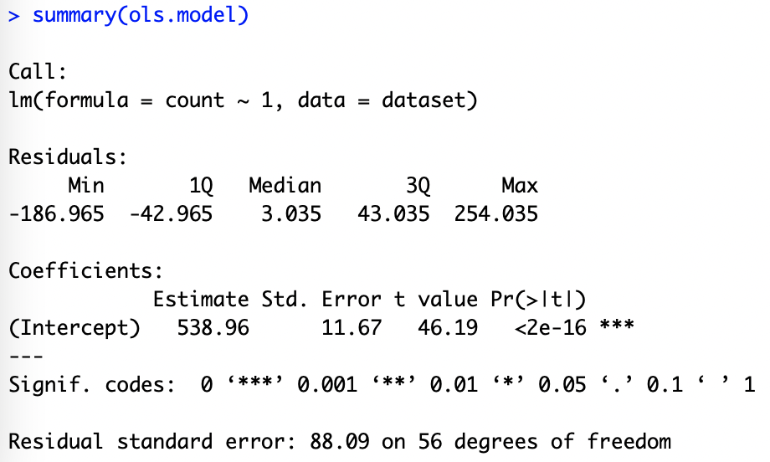

Slide 19
# Input dataset and x,y axis variables
ggplot(dataset,aes(x=time,y=count)) +
# Add points
geom_point(color="pink") +
# Add fitted line
geom_line(aes(x=time,y=ols.model$fitted.values),color="red") +
# Change figure aesthetics
xlab("Month") +
ylab("Number of Outpatient Visits") +
ylim(c(0,900)) +
theme_bw()

Slide 21
Intercept and Time Model
outcome_{t} =β₀+ε_{t}
outcome_{t} =β₀+ β₁·time+ε_{t}
Notes:
B0: expected outcome at first time point
B1: pre-existing trend in the outcome of interest
B2: immediate change in the level of the outcome after the intervention (first var of interest)
B3: change in the trend of the outcome following intervention (second var of interest)

Slide 22
# Run a linear model with an intercept term and time term
ols.model.time <- lm(count ~ time, data=dataset)
# Different functions to work with the model
# Print a summary of the results
summary(ols.model.time)
# Produce confidence intervals
confint(ols.model.time)

Slide 23
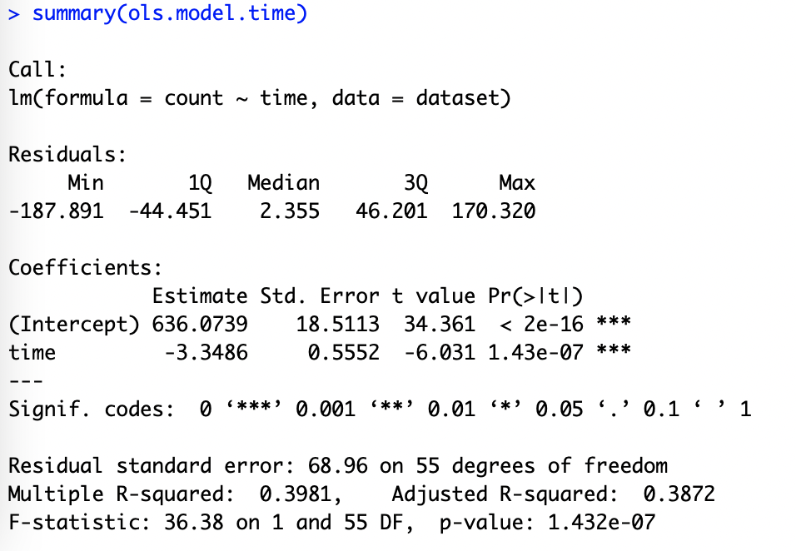

Slide 25
Intercept and Time Model
outcome_{t} =β₀+ε_{t}
outcome_{t} =β₀+ β₁·time+ε_{t}
outcome_{t} =β₀+ β₁·time+β₂·time²+ε_{t}
Notes:
B0: expected outcome at first time point
B1: pre-existing trend in the outcome of interest
B2: immediate change in the level of the outcome after the intervention (first var of interest)
B3: change in the trend of the outcome following intervention (second var of interest)

Slide 26
# Run a linear model with an intercept term and square term
ols.model.time2 <- lm(count ~ time + I(time^2), data=dataset)
# Different functions to work with the model
# Print a summary of the results
summary(ols.model.time2)
# Produce confidence intervals
confint(ols.model.time2)

Slide 27
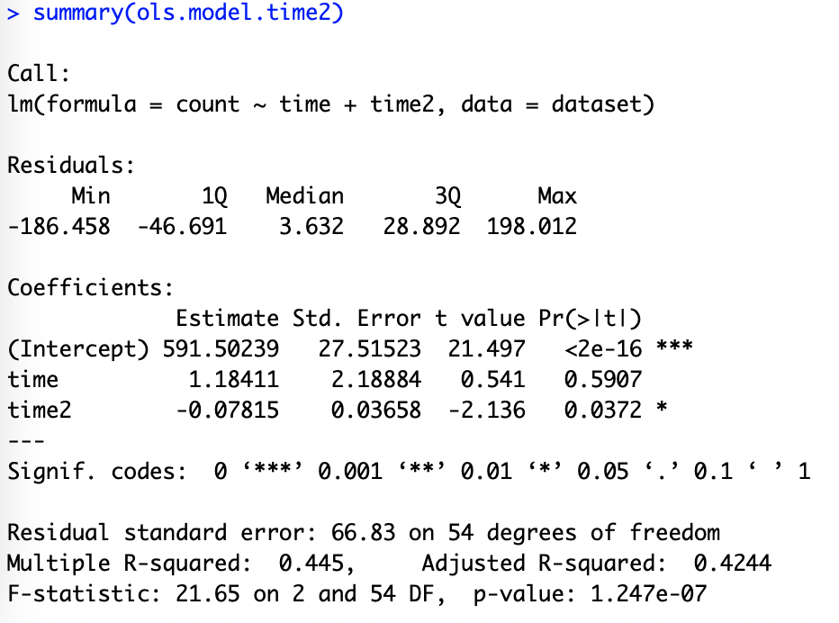

Slide 29
Step 4: Autocorrelation

Slide 30
What is autocorrelation?
Relationship in data points over time
Means the data points are not independent
Two types we will discuss:
Autoregression
Moving Average

Slide 31
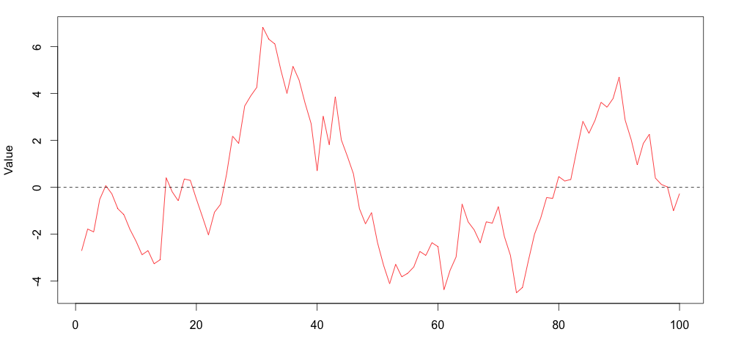
Autoregression
Notes:
Autoregressive (1)
Phi is the parameter, upsilon represents remaining error term
Regression error of each point is related to the one before it

Slide 32
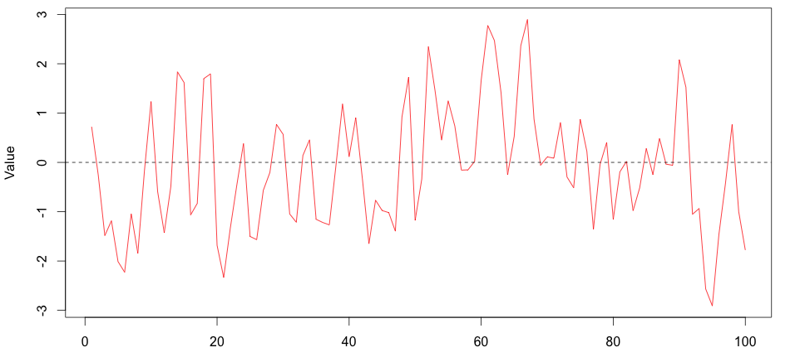
Moving Average
Notes:
Moving Average (1)
upsilon represents error term and previous error term, theta is relationship
Size of the random shock is related to the one before it

Slide 33
Methods to Check Autocorrelation
Several methods, including:
Durbin-Watson test
Residual plots
ACF and partial-ACF plots

Slide 34
Durbin-Watson test
A formal test that tests for correlated residuals
Interpretation
Values of 2 indicate no autocorrelation
lower values indicate positive correlation, higher indicates negative correlation
# Durbin-watson test, 8 time periods
dwt(ols.model.time2,max.lag=8,alternative="two.sided")

Slide 35
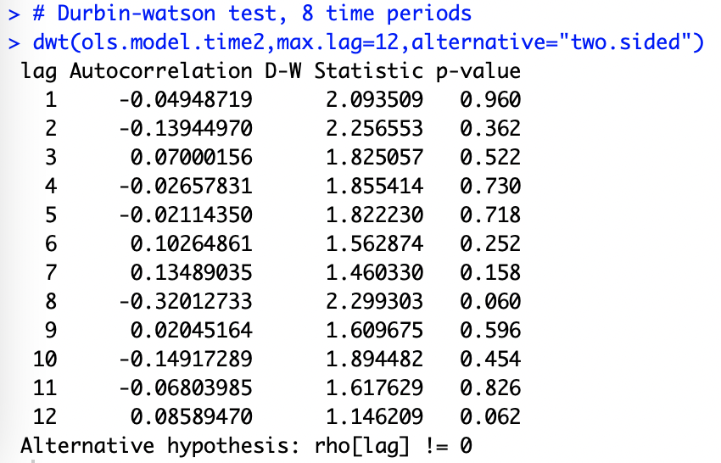

Slide 36
Residual plot
Use a residual plot to visually inspect for independence
ggplot(dataset,aes(x=time,y=ols.model.time2$residuals)) +
# Add points
geom_point(color="red") +
# Add fitted line
geom_line(color="red") +
# Add horizontal line through zero
geom_hline(yintercept=0,linetype="dashed") +
# Change figure aesthetics
xlab("Time") +
ylab("OLS Residuals") +
theme_bw()

Slide 38
Autocorrelation plots
A plotting method with which you can assess autocorrelation and moving averages
Two plots
Autocorrelation
Partial autocorrelation
Notes:
ACF: correlation of a variable with itself over time
PACF: correlation of a variable with itself after removing linear dependance

Slide 39
Model | ACF | Partial ACF
No autocorrelation | All zeros | All zeros
Autoregressive (p) | Exponential Decay | p significant lags before dropping to zero
Moving Average (q) | q significant lags before dropping to zero | Exponential Decay
Both (p,q) | Decay after q^{th} lag | Decay after p^{th} lag

Slide 40
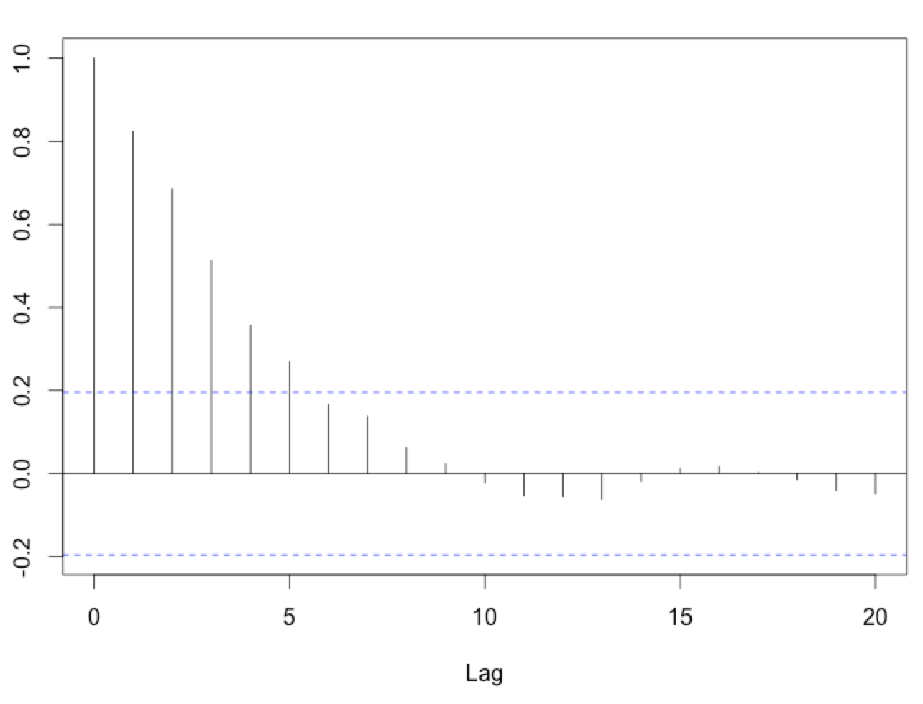
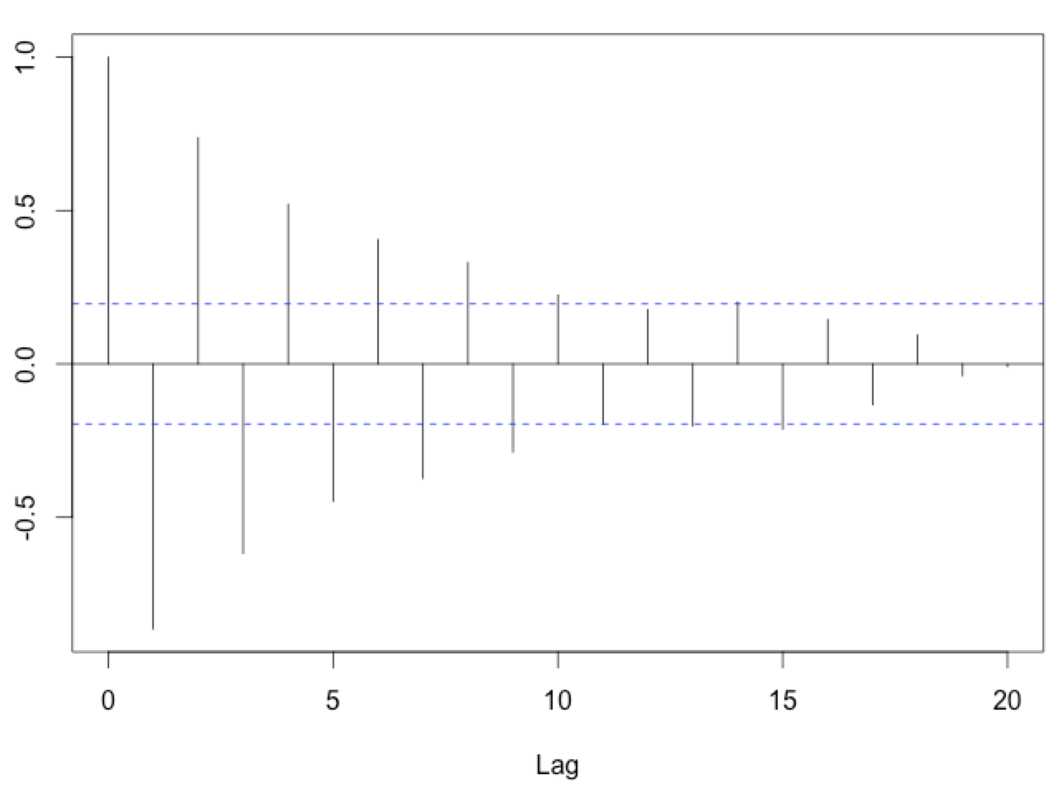
Examples of Exponential Decay

Slide 41
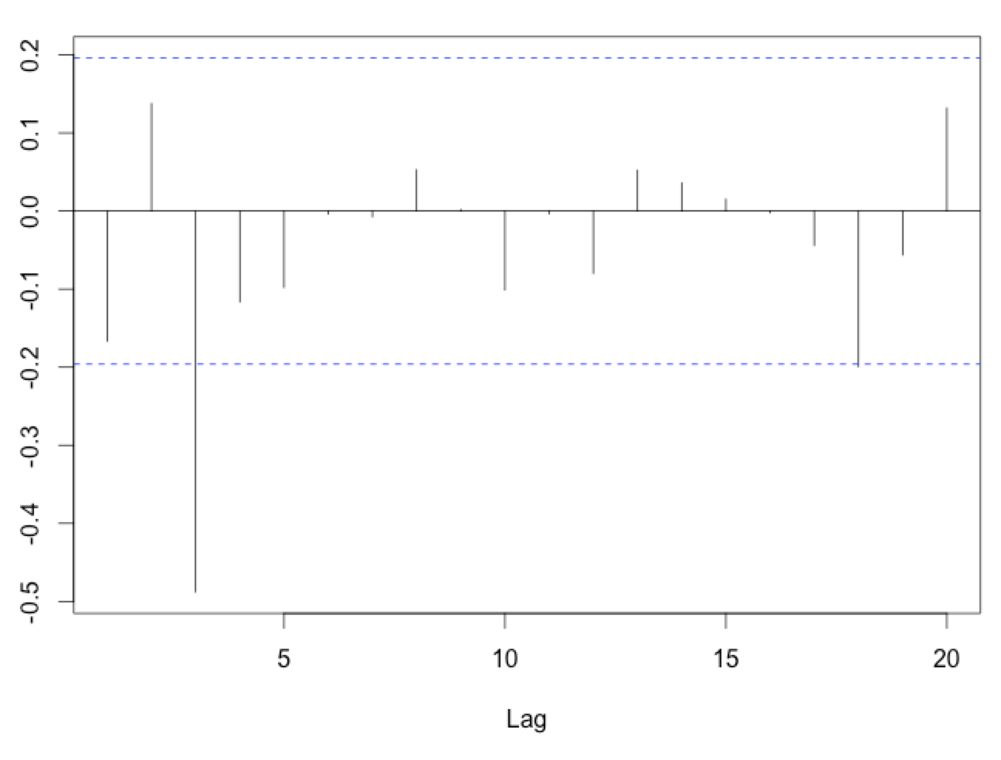
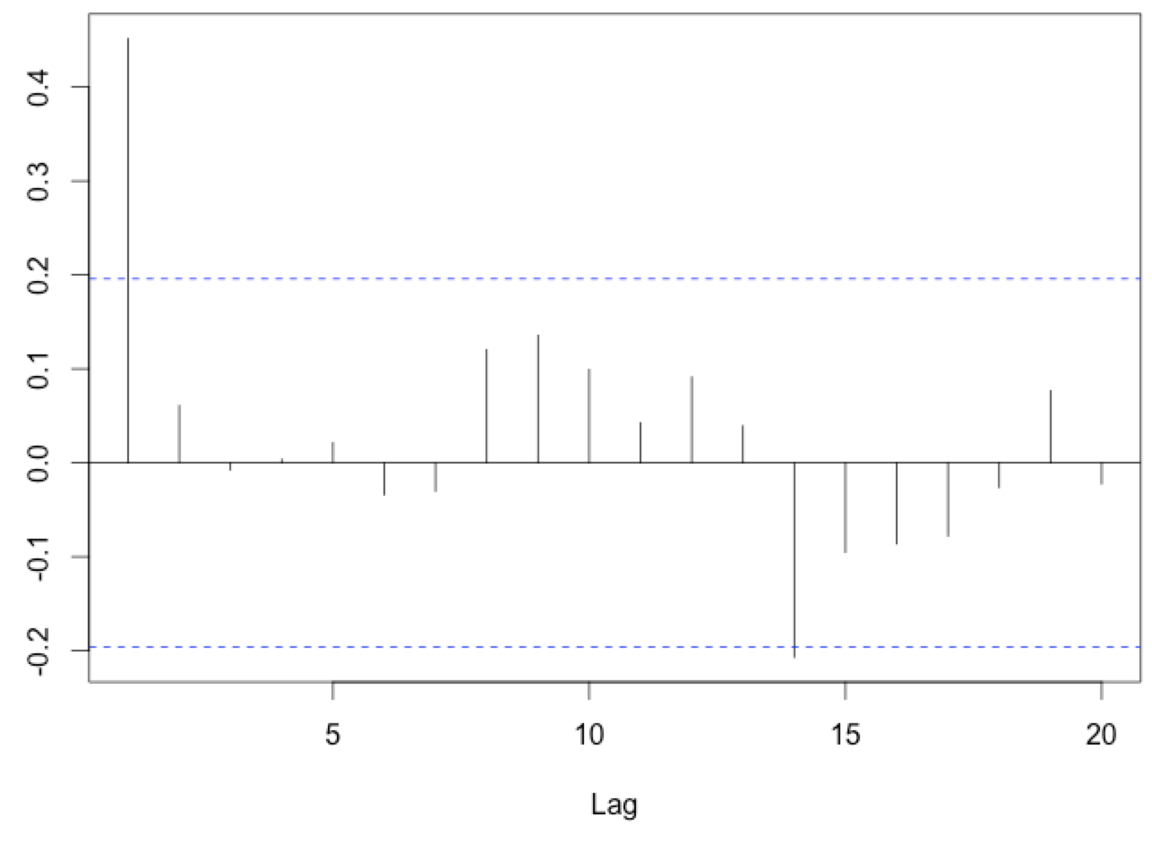
Examples of Significant Lags

Slide 42
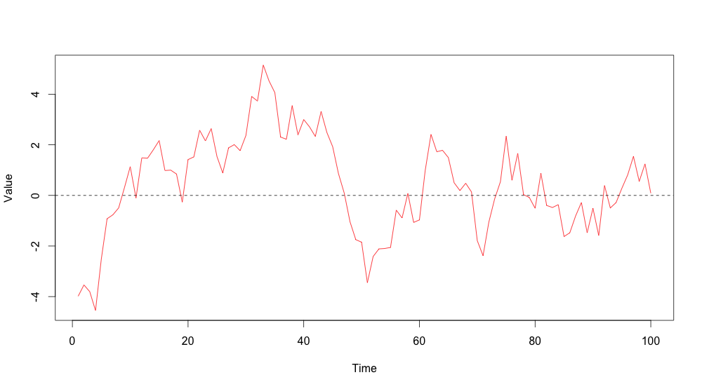
Notes:
Autoregressive (1)
Phi is the parameter, upsilon represents remaining error term

Slide 43
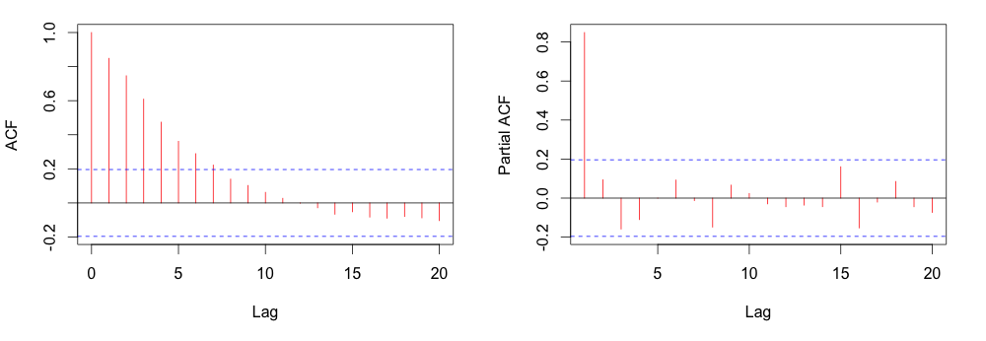
Notes:
Exponential decay on ACF, spike at 1 on PACF
Conclude AR(1) process for modeling

Slide 44
Model | ACF | Partial ACF
No autocorrelation | All zeros | All zeros
Autoregressive (p) | Exponential Decay | p significant lags before dropping to zero
Moving Average (q) | q significant lags before dropping to zero | Exponential Decay
Both (p,q) | Decay after q^{th} lag | Decay after p^{th} lag

Slide 45
Producing ACF/PACF plots
# Plot ACF and PACF
# Set plotting to two records on one page
par(mfrow=c(1,2))
# Produce plots
acf(residuals(ols.model.time2),main="ACF")
acf(residuals(ols.model.time2),type='partial',main="PACF")
# Reset the plotting
par(mfrow=c(1,1))

Slide 46
Notes:
Note the 8 on the right—consistent with the DWT

Slide 47
Step 5: Run the Final Model

Slide 48
Where we are now
Setup data
Visually inspect the data
Preliminary analysis
Check for and address autocorrelation
Run the final model and plot the results

Slide 49
Running the final model
Use function gls (similar specification to lm)
If we wanted to use AR(1), for example:
# Fit the GLS regression model with AR(1)
model_final <- gls(count ~ time + time2,
data=dataset,
correlation=corARMA(p=1,form=~time),
method="ML")
summary(model_final)

Slide 50
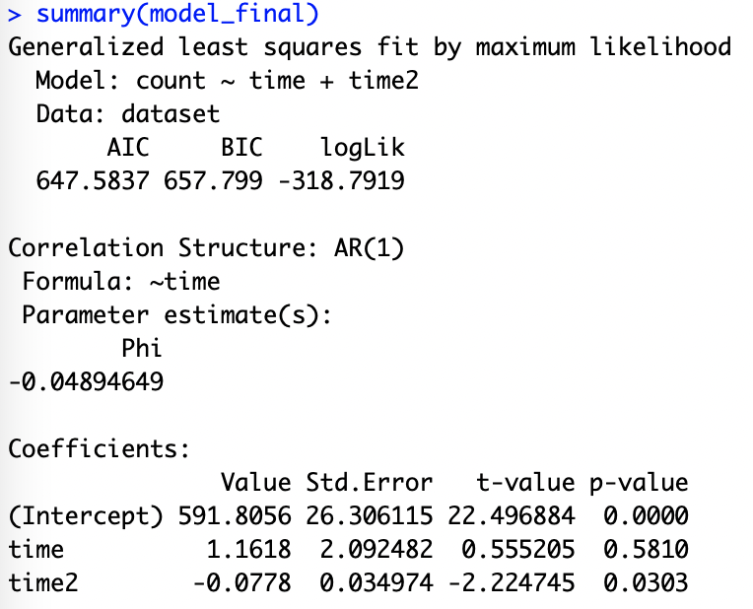

Slide 52
Next week...
Seasonality
Predictions
Syndromic surveillance models

